Slide 1
DATA607 Fall 2018 Final Presentation
DATA607 Fall 2018
John K. Hancock
Notes:
Welcome to my presentation on Relational Databases and R.

Slide 2
Sentiment Analysis:
NY Times Movie Reviews
and
Box Office Performance

Slide 3
Hypothesis Test
H0: The sentiment of a NY Times review has no effect (positive or negative) on the box office performance of a movie
HA: The sentiment of a NY Times review does have an effect (positive or negative) on the box office performance of a movie

Slide 4
Project Methodology
Data was collected from two sources, the NY Times API and the website the-numbers.com
Data was explored, cleaned, and prepared for Sentiment Analysis
Perform tidytext sentiment analysis using the NRC, Bing, and AFINN lexicon
Regression analysis between the sentiment and box office performance

Slide 5
Data Collection
Web scrape the-numbers.com website tracks 2018 box office gross figures
NYTimes API for the movie reviews
Issues with collection
Saved results into csv files

Slide 6
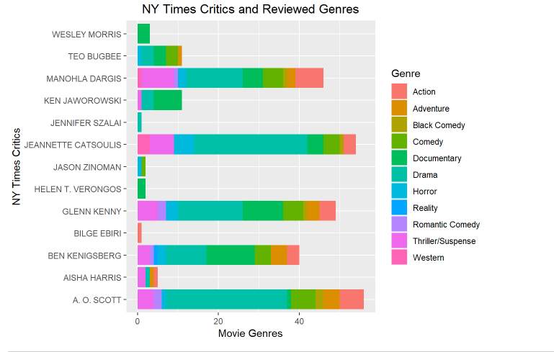
Data Exploration Highlights

Slide 7
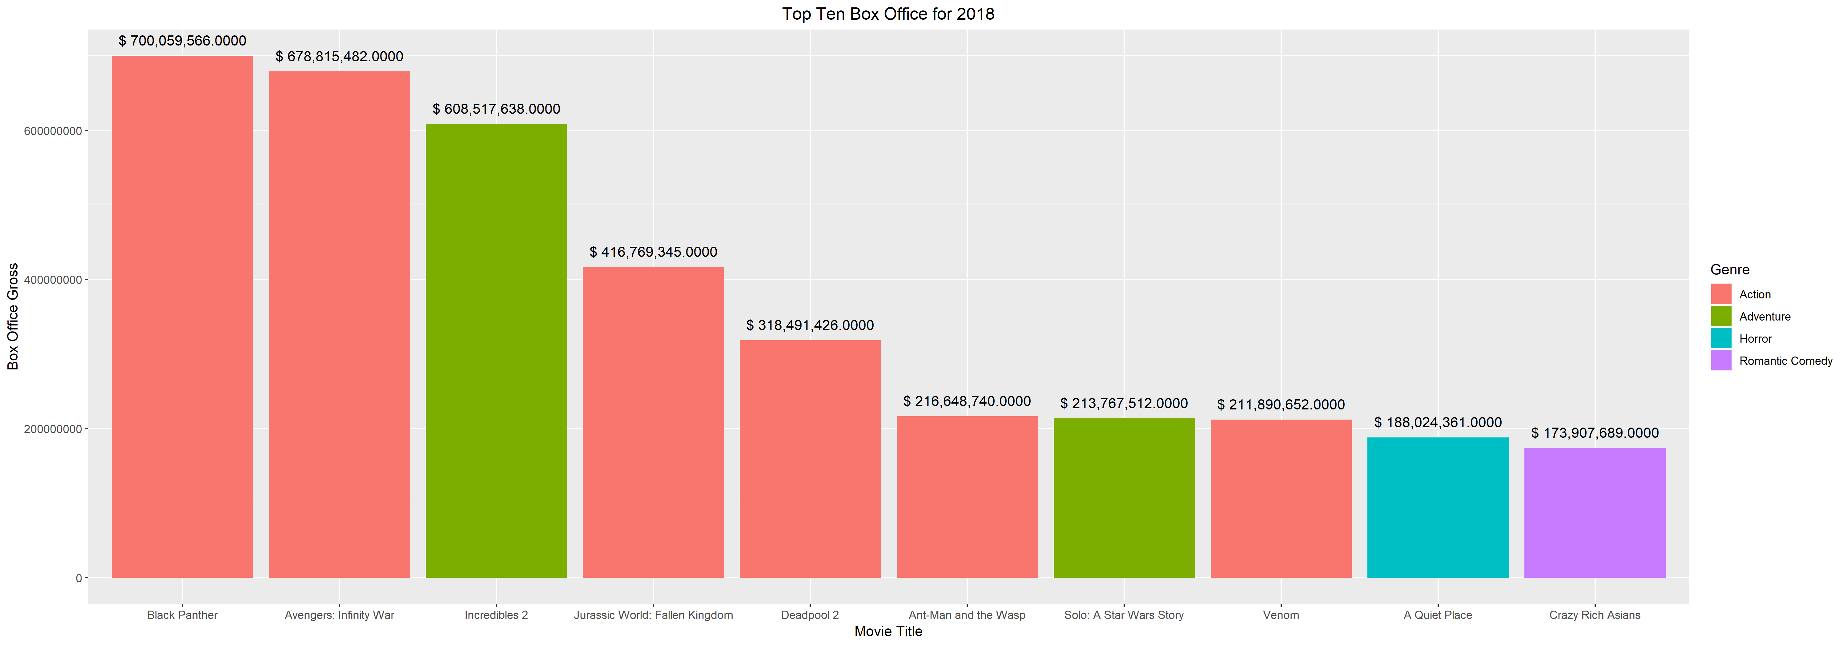
Data Exploration Highlights

Slide 8

Tidytext Sentiments Analysis – Key References
Notes:
Text Mining with R

Slide 9
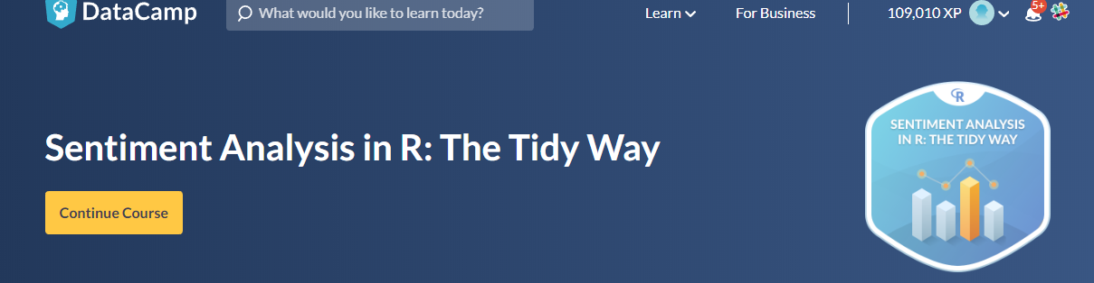
Tidytext Sentiments Analysis – Key References

Slide 10
TidyText Sentiment - Lexicons
NRC - List of English words and their associations with eight basic emotions (anger, fear, anticipation, trust, surprise, sadness, joy, and disgust) and two sentiments (negative and positive).
BING - Labels words as positive or negative.
AFINN - assigns words with a score that runs between -5 and 5, with negative scores indicating negative sentiment and positive scores indicating positive sentiment.

Slide 11
Tidytext Sentiment Analysis – Workflow
Data Preparation
Remove contractions, undesirable words, and stopwords
Unnest the Review variable in the Movies dataset which creates a new observation per word
Join the words with the lexicons
Execute Sentiment Analysis

Slide 12
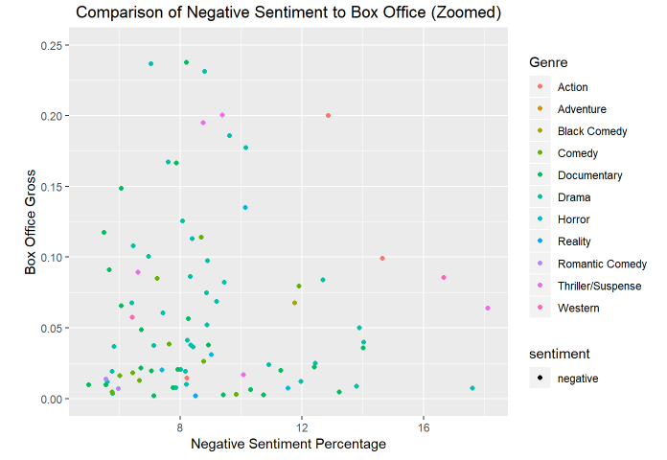
Summary of Findings - No Relationship (NRC)

Slide 13
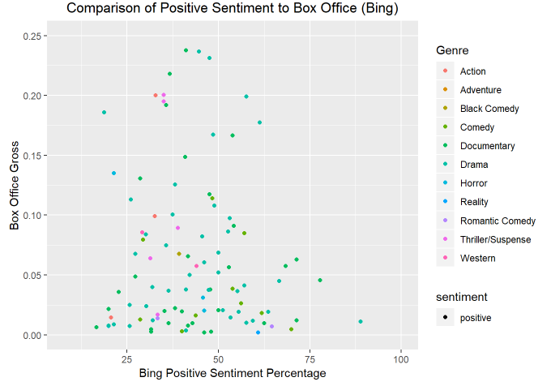
Summary of Findings - No Relationship (Bing)

Slide 14
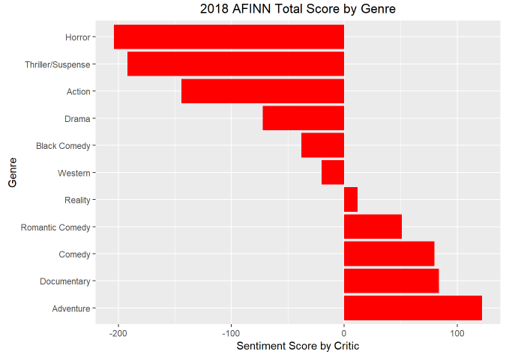
Summary of Findings - No Relationship (AFINN)

Slide 15
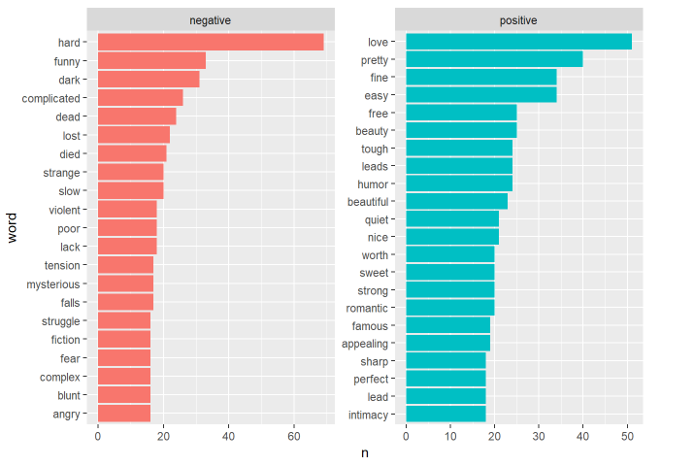
Words Used in Sentiment

Slide 16



Regression Analysis – Statistically Insignificant
NRC
AFINN
Bing

Slide 17
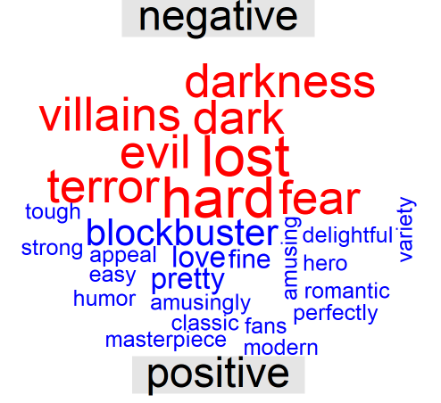
Nuanced NY Times Reviews

